Slide 1
A Business Case for IVM in Electric and Other Utility Rights of Way
Integrated Vegetation Management
Reduces Risk
and
Increases Asset Value for Operators
Notes:
This template is designed to be modified by the user for their specific audience. Imagery, logos and backgrounds have been left out so the user can incorporate imagery that suits their Company.

Slide 2
What is Integrated Vegetation Management?
Integrated Vegetation Management (IVM):
IVM is generally defined as the systematic practice of promoting compatible, stable, low-growing plant communities—that will resist invasion by tall-growing tree species—through the use of appropriate, environmentally sound, and cost-effective control methods. Adopted as ANSI A300 (Part 7) in 2018, IVM is the Industry Standard accepted by regulators, public agencies, Non-Governmental Organizations and academics.
Notes:
Differentiate between IVM methods and historical, incompatible species clearance practices of mowing, pruning and removals.

Slide 3
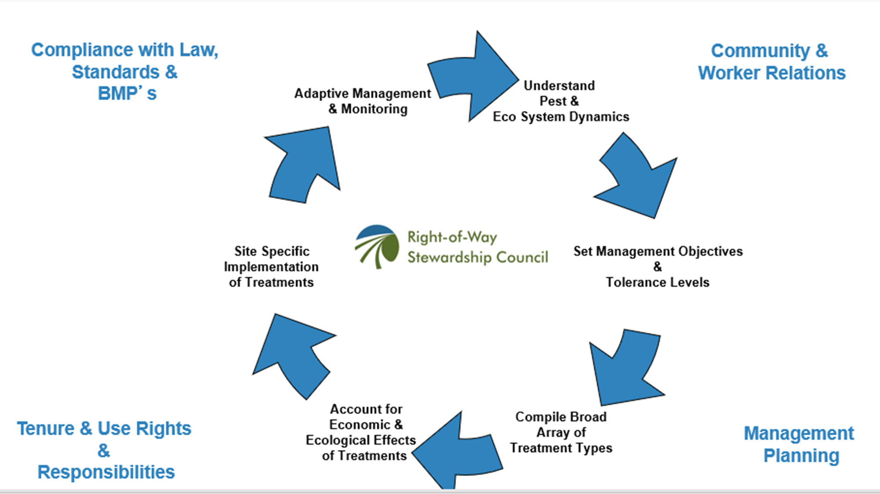
IVM is a Process of Continual Improvement
IVM can be viewed as a system based on a continuous cycle of information gathering, planning, implementing, reviewing, and improving vegetation management treatments and the related actions that a utility might undertake to meet its business and environmental needs.

Slide 4
Six Step IVM System
Set Objectives
Define Action Thresholds
Evaluate & Select Control Methods
Implement IVM
Monitor & Quality Assurance
Evaluate Site
Notes:
Objectives: Objectives are clearly defined and often include high-level objectives as well as site specific objectives. Objectives will vary from utility to utility and from one site to another. The focus should be on environmentally-sound, cost-effective control of species that could conflict with facilities while promoting compatible, early successional, sustainable plant communities
Evaluate Site: Assess field conditions to plan work. Collect data to establish site specific objectives, set budgets, determine resource requirements, and identify safety, environmental, and other factors.
Define Action Thresholds: defining vegetation height, density, location, or condition that triggers specific vegetation control methods. Action thresholds may vary between utility based on multiple factors such as growth rate, density, cycle of return, fire risk, and past control methods.
Evaluate and Select Control Methods: based on the objectives, site evaluation, and action thresholds, the utility will determine the best control methods to be used at a particular site. The most common control methods are a combination of chemical, biological, cultural, mechanical and/or manual treatments
Implement IVM: Vegetation is treated using the control methods defined for each site
Monitor Treatment and Quality Assurance: Effective IVM must have processes to evaluate results during and after work. Systems should be in place to document and verify work was completed to expectations and achieved defined objectives. This review can identify where additional work is needed opportunities for improvement and refine site specific objectives.

Slide 5
Why Employ IVM?
Employing IVM in energy rights-of-ways results in a variety of benefits:
Increased Safety for the Operation
Increased Economic Performance
Increased Regulatory Compliance
Improved Environmental Outcomes
Improved Stakeholder Relations
Increased Employee Satisfaction
Notes:
IVM is the best-in-class ROW approach to Vegetation Management (VM); utilities have a fiduciary responsibility as most VM costs are passed through to consumers.

Slide 6
Operational Safety Benefits of IVM
Improves safety and reliability of the grid
IVM maintains less vegetation encroachment, so infrastructure and facilities are easier to access, inspect and maintain, reducing costly power outages
Long term maintenance will require less work at height and more ground based work thereby reducing worker exposure
Notes:
Using the best-in-class approach (IVM) also adheres to both social and governance impacts and can benefit community and social justice needs as well.

Slide 7
Economic Benefits of IVM
IVM is less expensive, long-term strategy
Cost-benefit analyses and Net Present Value calculations
As the ROW vegetation community transitions, utility companies spend less money maintaining the ROW through reduced need for mechanical controls (e.g., mowing) and more focused, selective chemical controls (e.g., herbicide application)
Contributes to ESG and Investor Targeted profiles
Creation of habitat supports biodiversity/sustainability goals
Notes:
Using the best-in-class approach (IVM) also adheres to both social and governance impacts and can benefit community and social justice needs as well.

Slide 8
Regulatory Compliance
Electrical faults from energized conductors to trees and other vegetation can result in significant interruptions, major outages to customers and penalties for not meeting reliability standards
IVM improves both federal and state regulatory compliance
FAC 003.4
FERC/NERC Reliability standards
Public Utility Commissions
Environmental Protection Agency (Federal and State)
Wildlife statutes such as ESA, etc.
Creates opportunities for voluntary conservation initiatives as wildlife habitat is created, protected and maintained, e.g., CCAA for monarch butterfly

Slide 9
Environmental Benefits of IVM
IVM creates stable plant communities, and if done with intention it creates compatible habitat that will provide:
Early successional habitat for many species
Nesting and perching sites for raptors
Rare plant refugia
Nesting and foraging sites for edge adapted species
Microclimates for amphibians and reptiles
Botanically diverse habitat for pollinators and other invertebrates
Greater biodiversity
Wildlife corridors
Reductions in stormwater run-off
Increased carbon sequestration
Improved air quality

Slide 10
Stakeholder Relations Benefits of IVM
IVM creates a positive story and improves relationships with stakeholders, investors, employees and customers:
Improves public relations and contribute to public acceptance or buy-in for projects
Public approval of new ROWs helps facilitate regulatory approvals
Customers benefit from lower costs and improved system reliability
Increases engagement with community and neighboring landowners
Provides opportunities to partner with civic & community groups
Creates green spaces in urban community; social and environmental justice concerns
Reduces wildfire risk through fuel load management and creation of firebreaks
Notes:
This only differs from old school approach of a properly executed VM program in its application of more methods and expanded, more mature values/goals.

Slide 11
Employee Engagement Benefits of IVM
IVM engages employees in creating value for the organization and society because it:
Requires employees obtain and provide greater levels of expertise
Involves employees in developing and maintaining long term solutions with a broad range of benefits
Employees play an active role in contributing to larger ESG/corporate goal
Engages employees, partners, and others in conservation
Provides opportunities to be involved with civic & community groups on positive outcomes

Slide 12
How to Realize the Benefits of IVM
Executive buy-in and support
Regulatory support and approval
Change in Funding Considerations
Modify/update specification and program documentation
Re-train and re-orient the workforce
In house staffing
Contractors
Notes:
These benefits extend to consumers, property owners, potential community and Non-Government Organization partnerships, science, etc.

Slide 13
Executive Buy-In and Support
IVM is the least costly and most beneficial ROW vegetation management strategy
Integrated approach projected savings 48% over 15-20 years (John Goodfellow 2018 The Cost Efficiency of IVM )
Reduction in management inputs, direct and indirect costs
Lower risk of vegetation encroachment between IVM treatments
Achieve objectives of safety, reliability, regulatory compliance, environmental benefits, business and investor performance
Notes:
IVM is the least costly and most beneficial ROW vegetation Management strategy, and this is most responsible and ethical vis a vis consumer, since VM costs are passed directly to consumers.
Integration of mechanical and herbicide- based prescriptions (along with other control methods) less costly than repeated treatments using only manual and mechanical techniques
Lower risk of vegetation encroachment between treatments
Wide array of benefits including public safety, operational risk, recreational use, public nuisance, site disturbance, water quality, compatible vegetation, incompatible vegetation (density & height), and a range of wildlife species
Achieve Management Objectives
Reduce operational risk
Maximize cost effectiveness
Integrated approach leads to reduction in tall trees and vegetation
Prevents further establishment of tall trees and vegetation in the future
Reduction in management inputs, direct and indirect costs
Effectiveness – produce desirable vegetation conditions
Safe and reliable transmission of electricity
Promotion of diverse plant and animal communities
Protection of riparian areas and water quality
Reduction in negative visual impact
Enhancement of opportunity for recreational endeavors

Slide 14
Regulatory Support and Approval
Update required regulatory filings with program plans
Explore rate recovery mechanisms
Improved reliability
Sustainability enhancements
Educate regulators on benefits of IVM to gain support
Biodiversity
Environmental stewardship
Improved business efficiencies
Social and governance impacts

Slide 15
Funding Considerations
Successfully implemented, IVM changes the approach to managing the right of way from risk management to asset management.
It typically requires an up front, capital investment
Net present value (NPV) and net present costs (NPC) calculations show positive results
Once initiated, the process must be continued in order to maximize the benefits, however costs will decrease over time
Aligns with and promotes Corporate strategic objectives
Notes:
Consider being specific on the Corporate strategic objectives this supports

Slide 16
Program Documentation
Incorporate IVM processes and implementation plan in contractor specification and program documentation
Review contracts and contractor specifications incorporate IVM and compatible species management standards, metrics, and incentives
Develop & incorporate elements of a long-term vegetation management plan
Develop IVM and compatible species training materials for Utility Vegetation Management Specialists, Work Planners & Contractors

Slide 17
Workforce Considerations
Re-train and re-orient the workforce
In house utility vegetation management specialists
Contractors
Consider additional resources and expertise required to implement IVM and compatible species management
Expand the scope of work and allotted time of work planners to write prescriptions account for IVM and compatible species
Create job descriptions (i.e., Roles, Responsibilities, Required Level of Knowledge, etc.) & rebrand as applied science where possible
Attract, train and retain herbicide contractors and link proficiency in plant identification to incentives, promotions and compensation

Slide 18
Appendices
Examples and Case Studies
Science, Research and Citations
IVM Process Flow Chart

Slide 19
Examples and Case Studies
John Goodfellow’s Cost of IVM
Cost-benefit Analysis Summary for the CCAA
CCAA Enrollment Timing Document
EPRI’s Ecosystem Services Decision Tree - Determining the Business Case (pg 23)
EPRI’s Business Case for Sustainability
Tree Fund’s The Cost of Deferred Maintenance

Slide 20
Science Research and Sources Cited
https://www.epa.gov/pesp/benefits-integrated-vegetation-management-ivm-rights-way#economic
http://www.rowstewardship.org/resource_pdfs/ivm_framework.pdf
https://www.gotouaa.org/wp-content/uploads/2019/06/Final-Report-Cost-efficiency-of-IVM.pdf
http://rightofway.erc.uic.edu/wp-content/uploads/2018/05/5B1EPRI-Ecosystem-Services-Decision-Tree-1.pdf

Slide 21
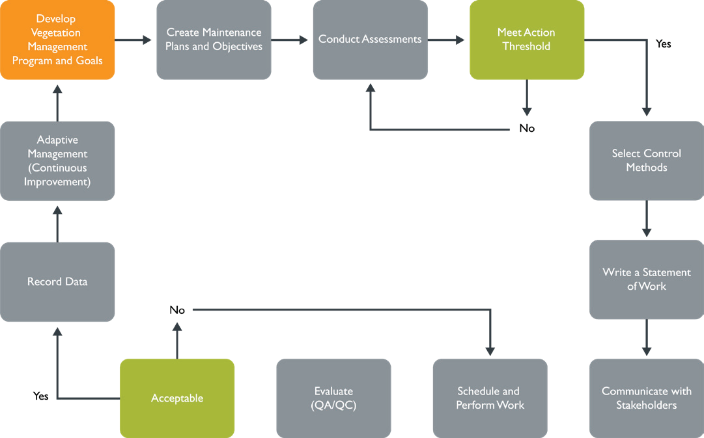
IVM Process Flowchart
Order of processes may vary or occur concurrently

